Slide 1

ACTIVE LEARNERS
CAN THO UNIVERSITY
COLLEGE OF INFORMATION & COMMUNICATION TECHNOLOGY
Thursday, August 17th, 2017
Group members: Tran Thi Vang Y - Bui Xuan Huynh
B1609621 - B1606894 – DI16V7F2
Notes:
Becoming a ACTIVE learner is very necessary in the world we live in today. Things change fast, and you need to upgrade yourself constantly to stay relevant.
After…. Have a better overview and become …

Slide 2

An active learner
Popular learning styles
1
Who is an active learner?
2
Why we want to be an active learner?
3
How to be an active learner?
4

Slide 3
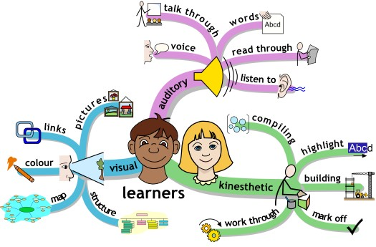
1
1
Styles
Popular learning styles
2
3
4
Notes:
First, there are 3 main learning styles that divide learners into 3 main groups.
….
But who is AN ACTIVE learner and which learning style are the most effective?

Slide 4
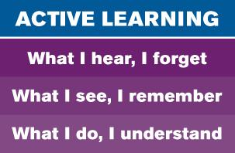
1
1
Styles
Learning Styles
2
3
4
Notes:
=>> Kinesthetic is the best way to learn new things effectivelly!

Slide 5
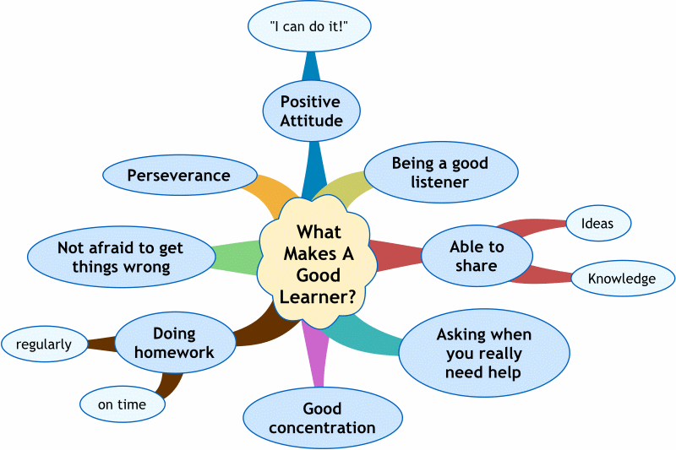
2
Who is an active learner?
1
2
Who?
3
4
Notes:
This leads us directly to my next point,…
Based on my observations, there are some characteristics that a good learner have.
They know who they are and what learning style is suitable for them.

Slide 6
3
Why we want to be an active learner?
1
2
To use your time effectively
To master the materials
To build up self confidence
To enhance your learning experience
To develop your skills
3
Why?
4
Notes:
Being in the field of IT, I can really feel the pace of things. It seems like no week passes without a new technology coming out. If I were satisfied with what I learned years ago, my skills would soon be obsolete.
I believe such a situation happens, not just in IT, but also in other fields. That’s why it’s important to constantly update your knowledge and refresh your skill set.

Slide 7
4
How to be an active learner?
1
L
2
isten
valuate understanding
lways check your work
ead carefully
ote the key words
njoy the process
epeat
E
3
A
R
4
How?
N
E
R

Slide 8
4
How to be an active learner?
1
2
3
Pursue seriously
and
effectively
Manage your time
Assess
what you did
Learn the materials before the class
Retry, redo and relax
4
How?
Prepare
Organize
Work
Evaluate
Rethink
Notes:
…
But it’s not enough. You need to make it become a study habit. I will give you my example when I prepare for my examination.

Slide 9
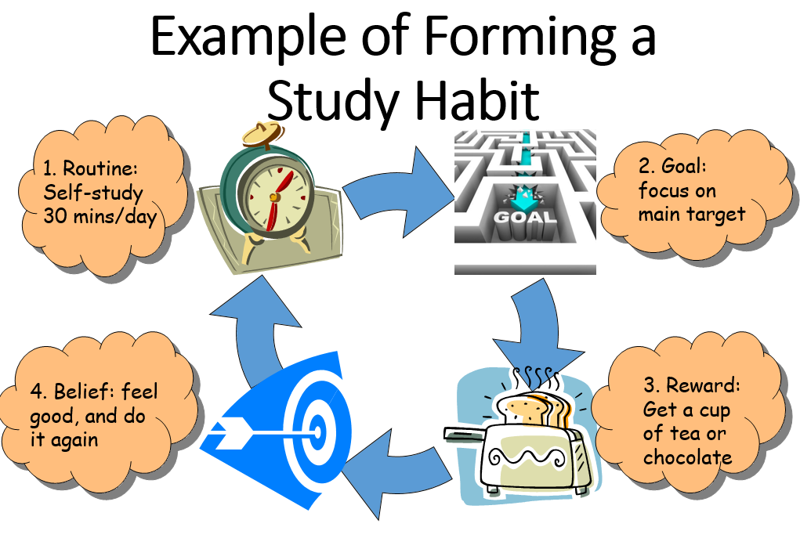
4
How to be an active learner?
1
2
3
4
How?
Notes:
…
After finishing semester exem, I will reward myself with a… Well, this give me a motivation for the next semester.

Slide 10
Conclusion
Popular learning styles
Who is an active learner?
01
02
An active learner
03
04
Reasons to be an active learner
How to be an active learner?
Notes:
In my mind, we have to be AN ACTIVE learner in modern life. The more we try, the better we are. Because knowledge is unlimited, we cannot stop learning.

Slide 11
CAN THO UNIVERSITY
COLLEGE OF INFORMATION & COMMUNICATION TECHNOLOGY
THANK YOU ALL FOR LISTENING
References:
[1] http://www.language.ca/index.cfm?Voir=sections&Id=17399&M=4032&Repertoire_No=2137991327 DATE??
[2] http://www.facultyfocus.com/articles/teaching-professor-blog/seven-characteristics-good-learners/
[3] http://notes.viphat.work/active-learning
[4] http://www.cit.ctu.edu.vn/~dtnghi/sg/power.pdf

